Slide 1
Perceptrons

Slide 2
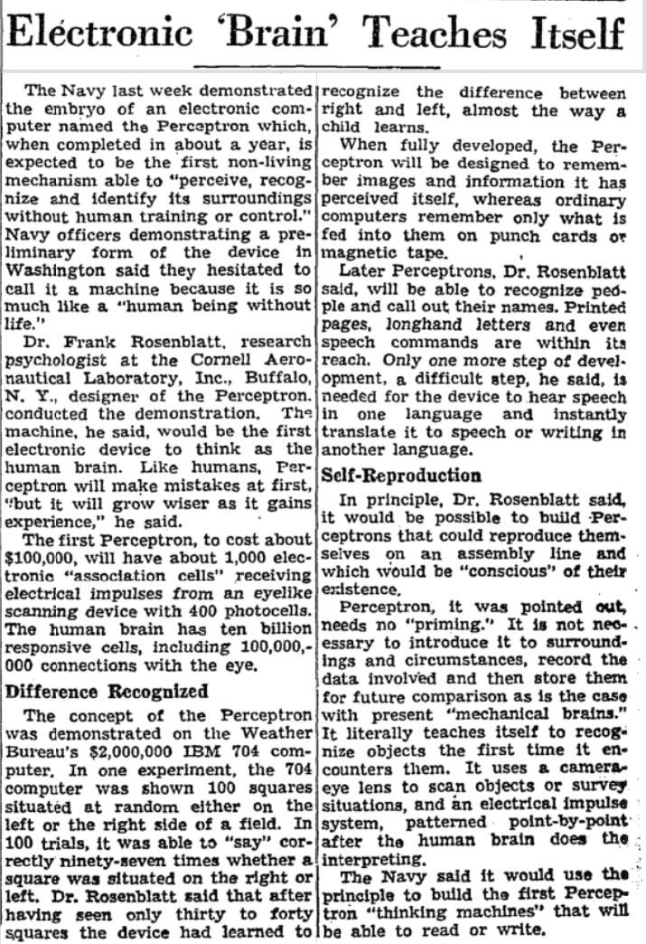
Perceptrons
Perceptrons were developed in the 1950s and 1960s loosely inspired by the neuron.
Notes:
New York Times - July 13, 1958 “Electronic 'Brain' Teaches Itself”
The Navy last week demonstrated the embryo of an electronic computer named the Perceptron which, when completed in about a year, is expected to be the first non-living mechanism able to "perceive, recognize and identify its surroundings without human training or control."

Slide 3
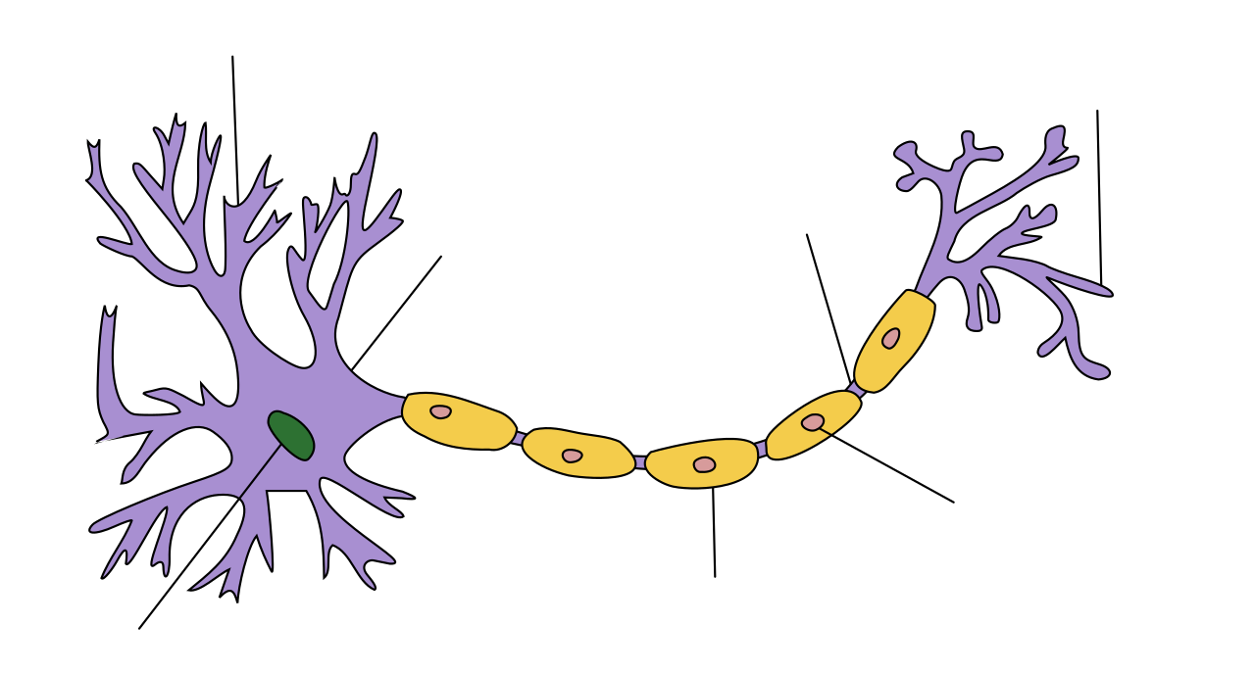
Neuron
Dendrite
Axon terminal
Node of Ranvier
Soma
Schwann cell
Axon
Nucleus

Slide 4
Perceptron
Inputs
Weights
x₁
w₁
Weighted
Sum
Activation Function
x₂
Σ w_{i} * x_{i}
w₂
ᵠ
Output
x₃
w₃
…
Threshold
x_{n}
w_{n}

Slide 5
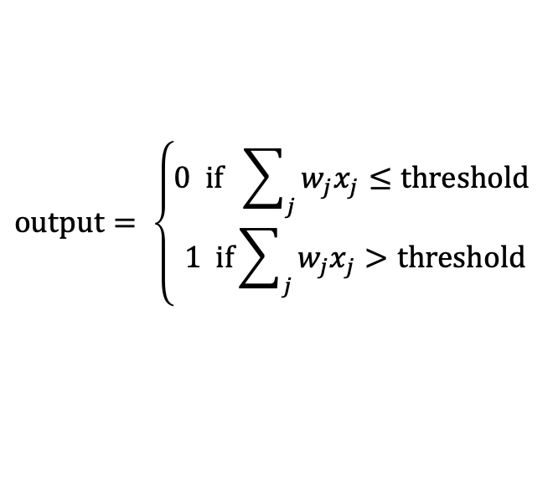
Perceptron
$$output= \left\{\begin{aligned}0 if \sum_{j}{w_{j}x_{j}≤threshold} \\ 1 if\sum_{j}{w_{j}x_{j}>threshold}\end{aligned}\right.$$
Inputs
Weights
x₁
w₁
Weighted
Sum
Activation Function
x₂
Σ w_{i} * x_{i}
w₂
ᵠ
Output
x₃
w₃
…
Threshold
x_{n}
w_{n}

Slide 6
Perceptrons for decision making
We can think about the perceptron or the sigmoid neuron as a device that makes decisions by weighing up evidence.
Example: Suppose there’s a cheese festival in your town. You like cheese.
Example from Michael Nielsen’s book Neural Networks and Deep Learning

Slide 7
Perceptrons for decision making
You might use 3 factors to decide whether to go.
Is the weather good?
Can your loyal companion come with you?
Is the festival near public transit?
These can be the binary input values to a perceptron

Slide 8
Perceptrons for decision making
By varying weights and the threshold we get different models of decision making
Example 1: w₁= 6 w₂ = 2 w₃ = 2, threshold = 5
Example 2: w₁= 6 w₂ = 2 w₃ = 2, threshold = 3
Notes:
Example 1: You adore cheese so much you’re happy to go without your loyal companion, even if it’s hard to get to, but you hate bad weather
Example 2: Lower the threshold to 3. Then the perceptron would decide that you should go to the festival whenever the weather was good or when both the festival was near public transit and your boyfriend or girlfriend was willing to join you.
Obviously, the perceptron isn't a complete model of human decision-making! But what the example illustrates is how a perceptron can weigh up different kinds of evidence in order to make decisions

Slide 9
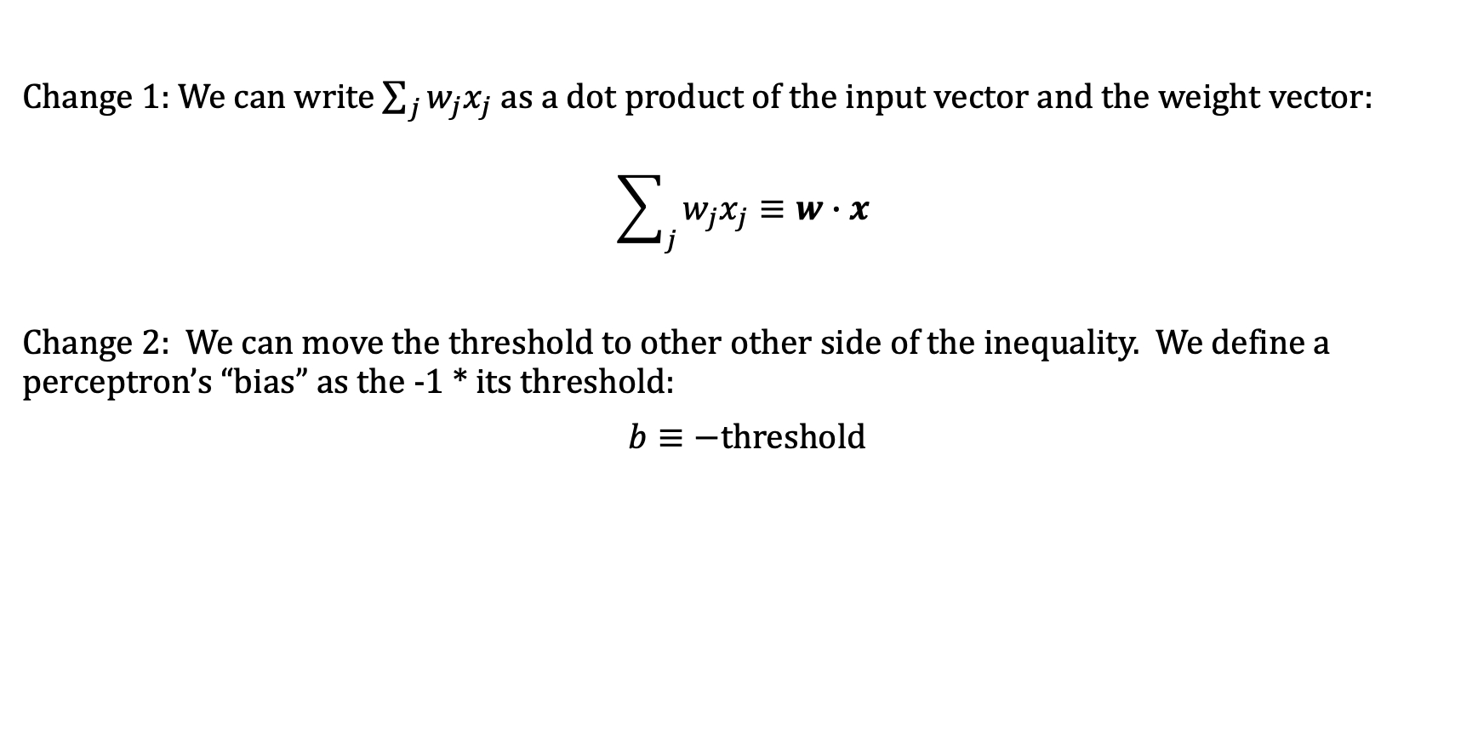
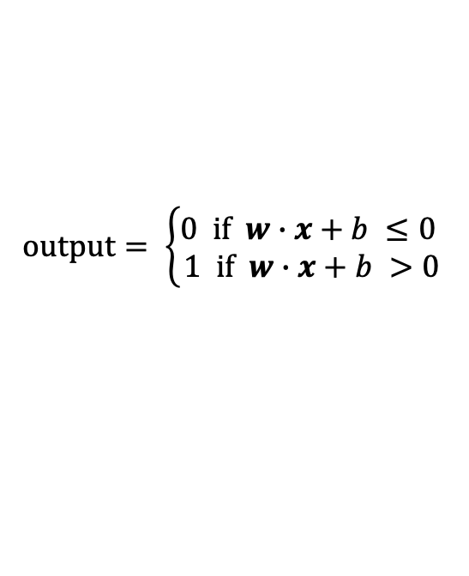
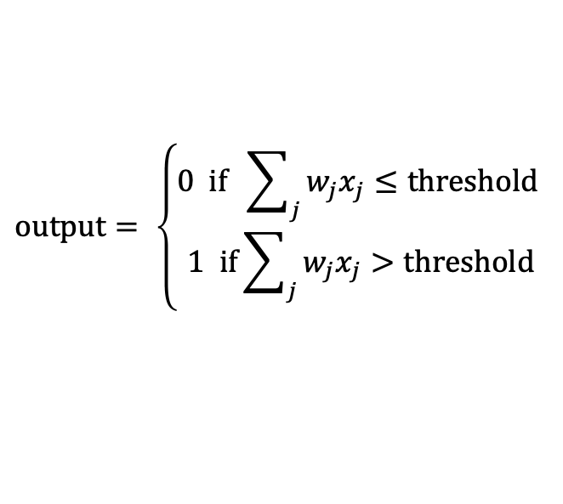
Notational changes
Change 1: We can write $\sum_{j}{w_{j}x_{j}}$ as a dot product of the input vector and the weight vector:
$$\sum_{j}{w_{j}x_{j}}≡w∙x$$
Change 2: We can move the threshold to other other side of the inequality. We define a perceptron’s “bias” as the -1 * its threshold:
$b≡−threshold$
$$output= \left\{\begin{aligned}0 if \sum_{j}{w_{j}x_{j}≤threshold} \\ 1 if\sum_{j}{w_{j}x_{j}>threshold}\end{aligned}\right.$$
$$output= \left\{\begin{aligned}0 if w∙x+b ≤0 \\ 1 if w∙x+b >0\end{aligned}\right.$$
rewrites to
Notes:
You can think of the bias as a measure of how easy it is to get the perceptron to output a 11. Or to put it in more biological terms, the bias is a measure of how easy it is to get the perceptron to fire. For a perceptron with a really big bias, it's extremely easy for the perceptron to output a 11. But if the bias is very negative, then it's difficult for the perceptron to output a 11.

Slide 10

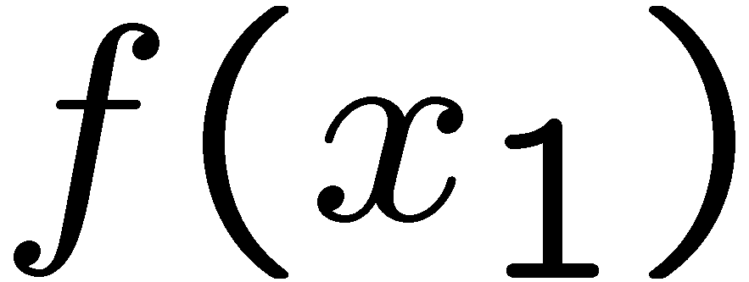
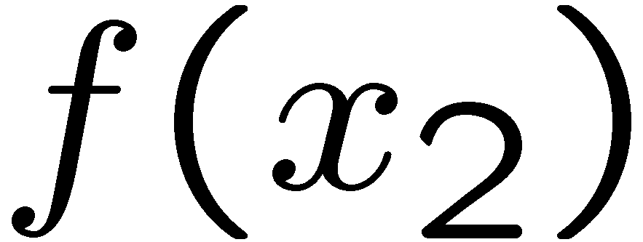
Learning weights from examples
Perceptions can be used for all kinds of classification problems.
Think of the inputs as features representing something we want to classify.
The feature values for inputs are fixed, but we can choose different weight vectors. Depending on the weight vector that we pick, we will get a different classifier.
# free : 2
YOUR_NAME : 0
MISSPELLED : 2
FROM_FRIEND : 0
...
# free : 4
YOUR_NAME :-1
MISSPELLED : 1
FROM_FRIEND :-3
...
# free : 0
YOUR_NAME : 1
MISSPELLED : 1
FROM_FRIEND : 1
...
Notes:
The feature values for inputs are fixed, but we can choose different weight vectors. Depending on the weight vector that we pick, we will get a different classifier.
Let’s look at an example, with the following weight vector. The first entry is a weight based on how often the word free appears. We get a high value for that. The next one is whether your name appears. This weight vector will lower the value. If there are misspelled words, the activation will go up. If the email comes from a friend then the activation will go up.
The weight vector always represents the positive class, so what is it in this case? It’s SPAM.
The weight vector lives in the same vector space as the feature vectors. Here’s are two feature vectors representing two emails that we want to classify.
For linear classification, we have a separating hyperplane. Separation is orthogonal to w. ((Draw this at a right angle to w)). Everything on the same side as w is the positive class Everything on the other side is the negative class.
For x2, the angle between w and f(x2) > 90 degrees, so it is negative.
If we compute the inner product then we’ll get a negative class when the angle is > 90 degrees like f(x_2).

Slide 11
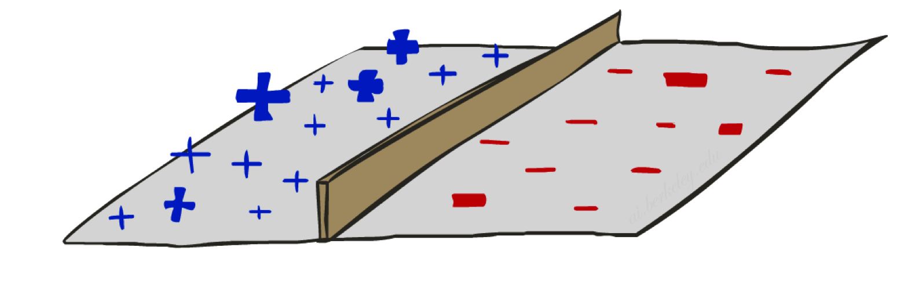

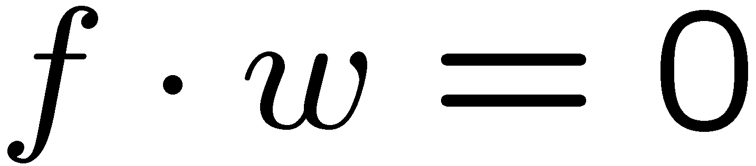
Binary Decision Rule
In the space of feature vectors
Examples are points
Any weight vector is a hyperplane
One side corresponds to Y=+1
Other corresponds to Y=-1
money
2
+1 = SPAM
1
BIAS : -3
free : 4
money : 2
...
0
-1 = HAM
0
1
free
Notes:
Here’s a simple 2-dim example to give some intuition.
Let’s say our weight vector looks like this.
We want to find the set of points where w*f(x) = 0. That’s the boundary.
Here’s the point for free, money ((draw point) ).
What does the bias term do? It allows us to shift the boundary away from the origin. In this case the Bias is -3. So w*featrures=3.

Slide 12
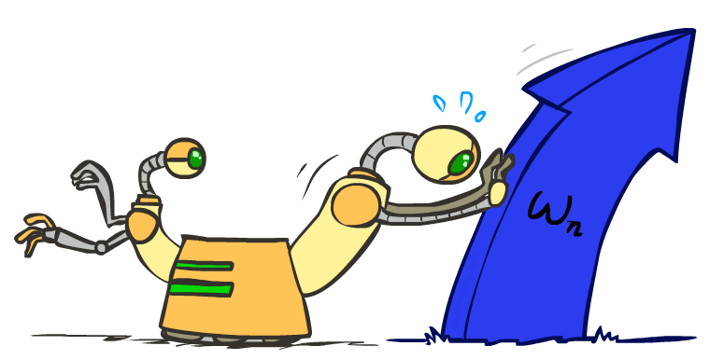
Weight Updates

Slide 13
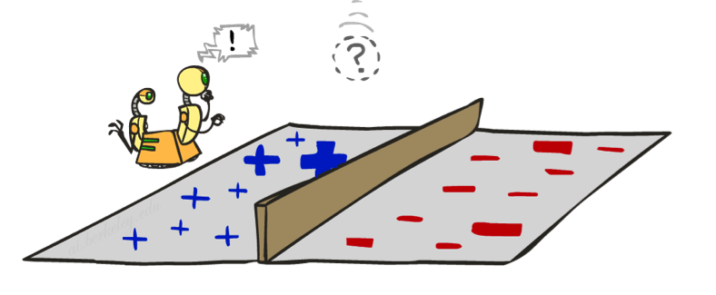
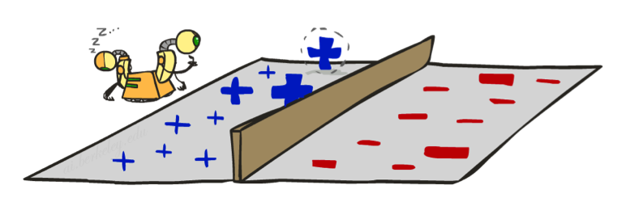
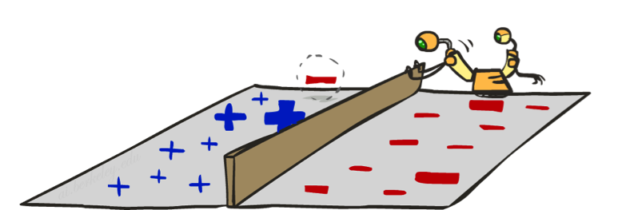
Learning: Binary Perceptron
Start with weights = 0
For each training instance:
Classify with current weights
If correct (i.e., y=y*), no change!
If wrong: adjust the weight vector
Notes:
Loop through every training example.
Try to classify that point with the current weights.
If the prediction is correct (e.g. y = y*) then you don’t make any change.
If the prediction is wrong, then let’s nudge the weight vector. This is just like with Q-learning where we nudged things in the direction of the correct value. Since it’s just one sample, we don’t want to dramatically change. So this is what we want to do with the perceptron too.

Slide 14
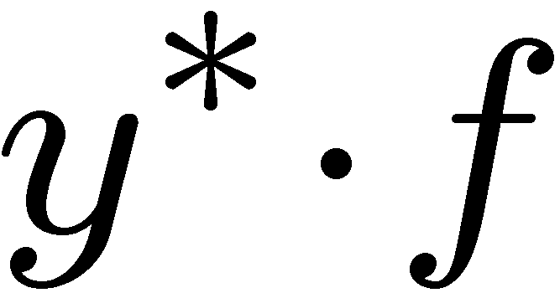

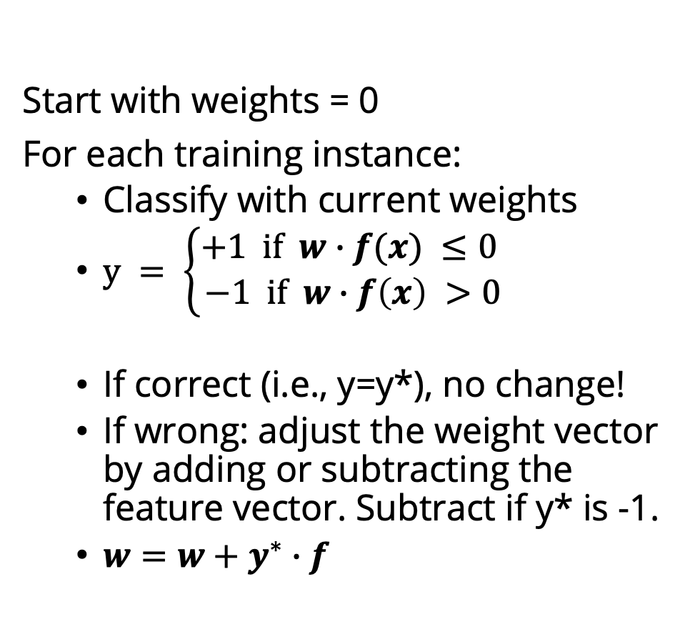
Learning a Binary Perceptron
Start with weights = 0
For each training instance:
Classify with current weights
$y = \left\{\begin{aligned}+1 if w∙f(x) ≤0 \\ −1 if w∙f\left(x\right) >0\end{aligned}\right.$
If correct (i.e., y=y*), no change!
If wrong: adjust the weight vector by adding or subtracting the feature vector. Subtract if y* is -1.
$w=w+y^{∗}∙f$
Notes:
Mathematically what does it look like? You start with zero weights, and then for each thing you classify by running this computation here: w*f(x) and checking whether that inner product is positive or negative. You classify x as positive if the inner product is >= 0, and negative if it is <0.
You then check the correct label y* in the training example. The training example will tell you whether it should be positive or negative. If you’re correct, then no change.
If you’re wrong, then we will make an adjustment. For the picture here, f(x) get’s a positive classification. Let’s say that the training data tells us that it should be negative. Then we need to somehow adjust this. We need to rotate w and f apart, so that they hopefully now have a negative inner product.
F is fixed. W is the thing that we can change. We want to change is so that it is less aligned with f. If we want to make it less aligned with f, then we add the negative of f to w. ((draw it)). If we add the negative of F to W, then we get a new W ((draw it), and our decision boundary changes ((Draw it as at a right angle to the new W)).
The f is now of the other side of the decision boundary than it was before, which is our goal).
So here’s the update that we use if the update is wrong: we add y* (+1 or -1) * f to w

Slide 15
TODO: Linear Algebra tutoral for MCIT students
Notes:
CCB – todo - add some slides about linear algebra

Slide 16
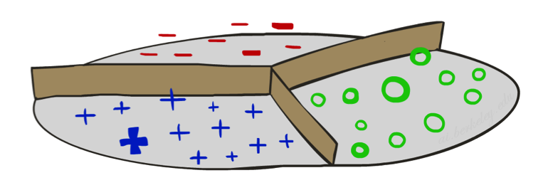
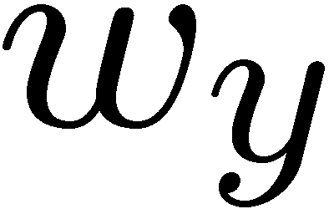
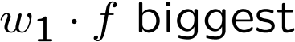
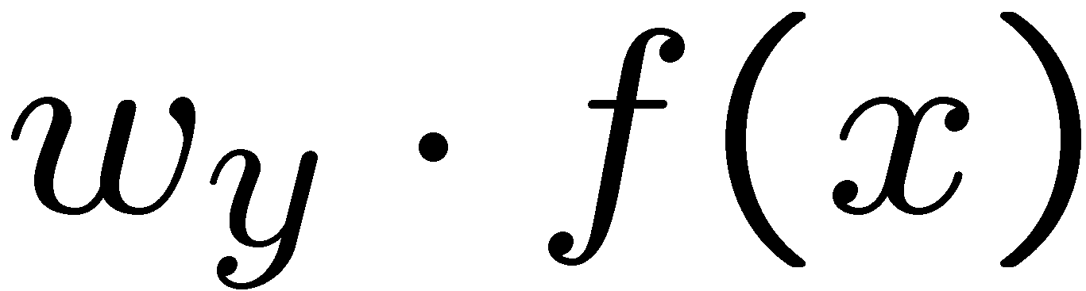

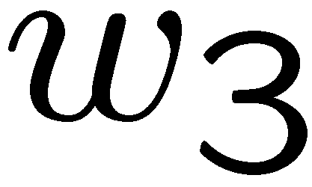
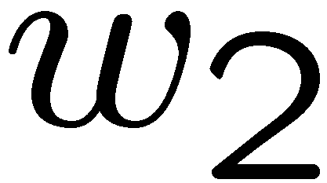
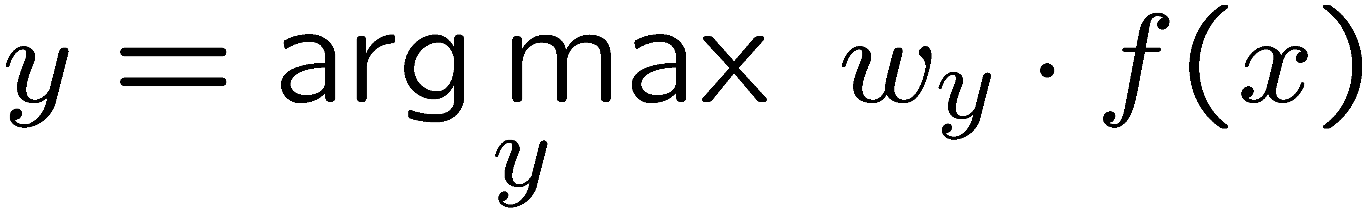
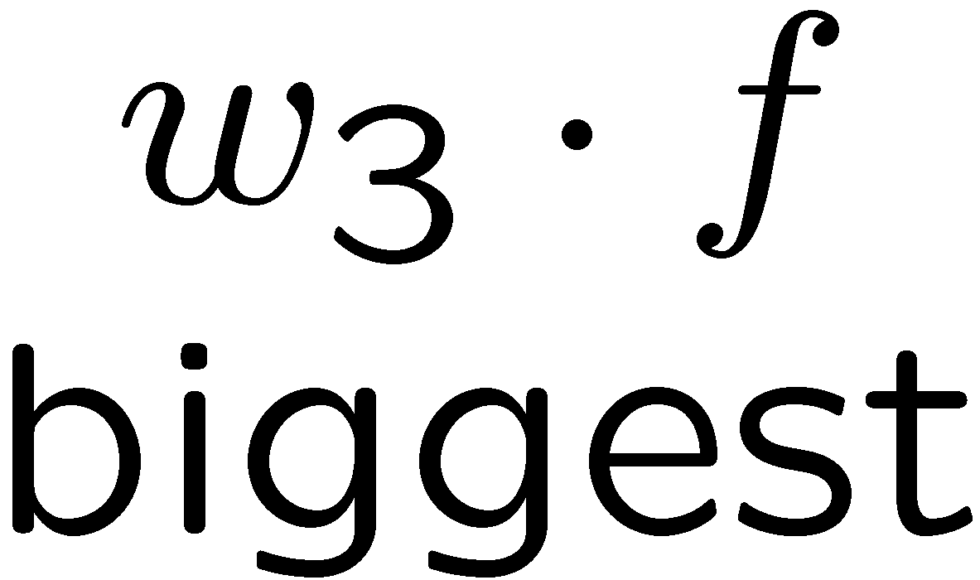
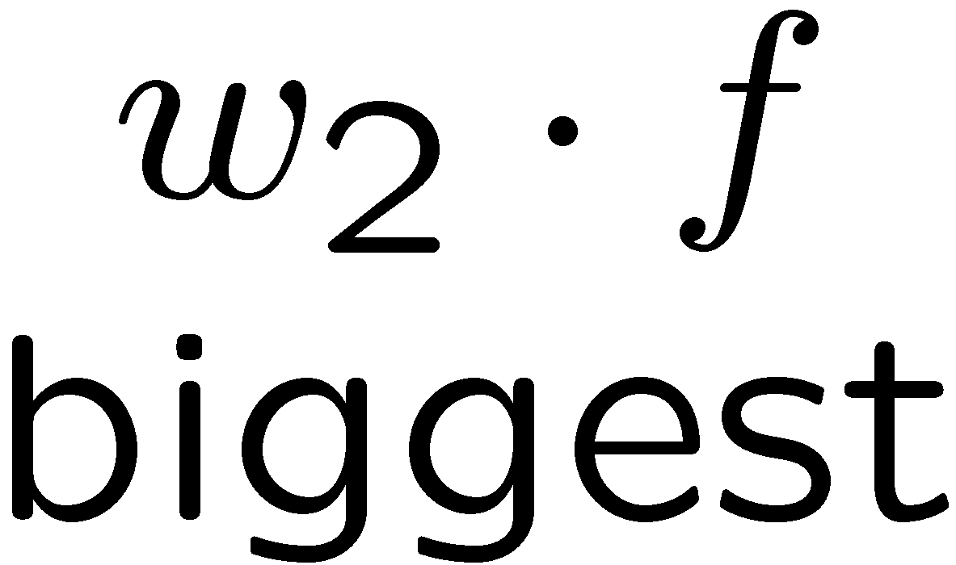
Multiclass Decision Rule
If we have multiple classes:
A weight vector for each class:
Score (activation) of a class y:
Prediction highest score wins
Binary = multiclass where the negative class has weight zero
Notes:
Here we’ll look at 3 classes on the slides, but this applies to any number of classes.
We have weight vector for each class.
If these are equal length, then the decision boundaries will be at the place that bisects the weight vectors (typically they won’t be equal length, which makes things a bit more complicated, but not much).
Now there is a w for each class (we index the classes by y). We compute w_y * f(x) for each class Y. Whichever one is the highest becomes our prediction for what class X should have.

Slide 17

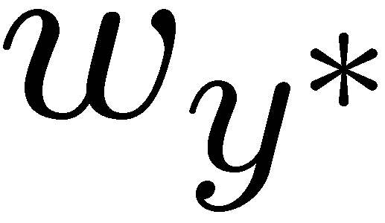

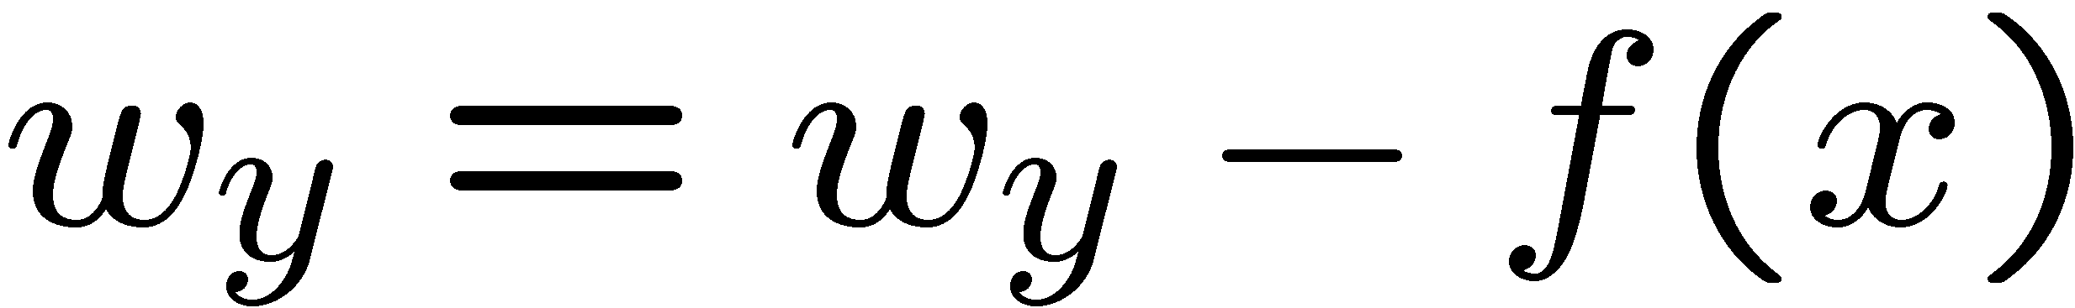
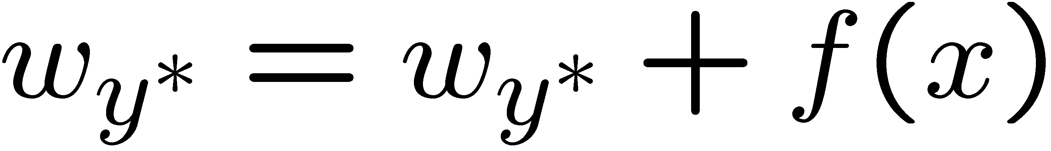
Learning: Multiclass Perceptron
Start with all weights = 0
Pick up training examples one by one
Predict with current weights
If correct, no change!
If wrong: lower score of wrong answer, raise score of right answer

Slide 18
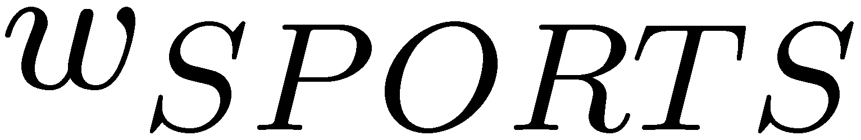
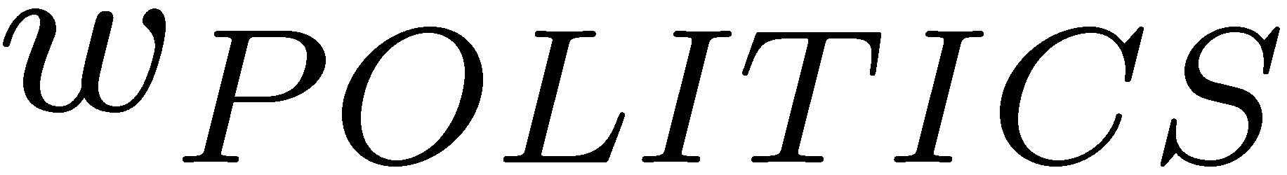
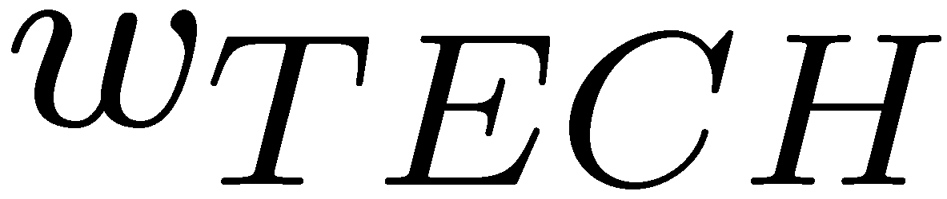
Example: Multiclass Perceptron
“win the vote”
“win the election”
“win the game”
BIAS : 1
win : 0
game : 0
vote : 0
the : 0
...
BIAS : 0
win : 0
game : 0
vote : 0
the : 0
...
BIAS : 0
win : 0
game : 0
vote : 0
the : 0
...
Notes:
Here are the initial weight vectors for each of our three classes. Now we have 3 inputs that we want to classify.
Let’s compute the values for each of the classes. It’s the inner product. Since sports has the bias term of 1, it wins. However, Let’s say that y* is poiitics.
We add f(x) to politics, which gives us a new w_politics of (1, 1, 0, 1, 1).
We subtract f(x) from sports, so we get a new w_sports of (0, -1, 0, -1, -1).
So that’s our first training example.
Let’s compute the score for “win the election”. The feature vector is 1, 1, 0, 0, 1.
For the inner products we get -2 for w_sports, 3 for w_politics and 0 for w_tech.
So the highest score is politics. That’s the correct label, so we don’t need to do any updates.
For win the game our f(x) is (1, 1, 1, 0, 1).
For the inner products we get -2 for w_sports, 3 for w_politics and 0 for w_tech.
Now we have to update by subtracting this f(x) from the politics weight vector, and add it to the sports weight vector.
Subtracting it out fom w_politics gives us new w_politics of (0, 0, -1, 1, 0).
We add f(x) tp sports, so we get a new w_sports of (1, 0, 1, -1, 0).
Then we go back to the first example. We keep looping until at some point, we run through all examples and nothing changes. If that’s the case then nothing will change in the future.

Slide 19
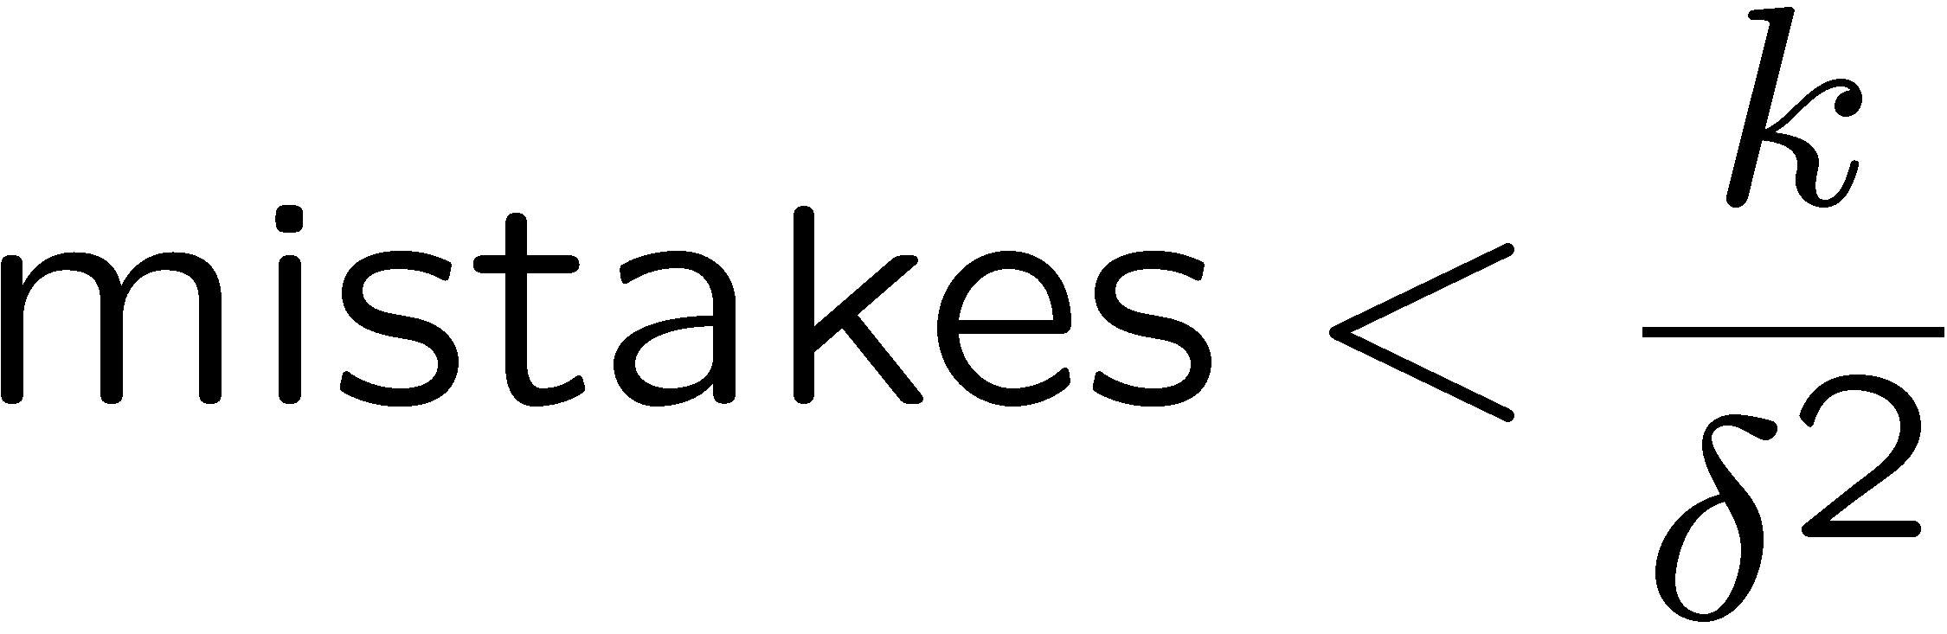
Properties of Perceptrons
Separable
Separability: true if some parameters get the training set perfectly correct
Convergence: if the training is separable, perceptron will eventually converge (binary case)
Mistake Bound: the maximum number of mistakes (binary case) related to the margin or degree of separability
Non-Separable
Notes:
You need to do at most this many passes.
K is the number of features. The more features that you have the longer it will take to converge.
Delta squared is the margin. If you have a separable data set, then you can compute the margin (the distance between the positive and negative class). If that margin (delta) is large, then it’s an easy cases, since there are many decision boundaries. If it’s small, then you have to be very precise before you find a separating hyperplane.

Slide 20
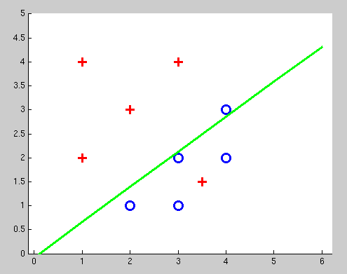
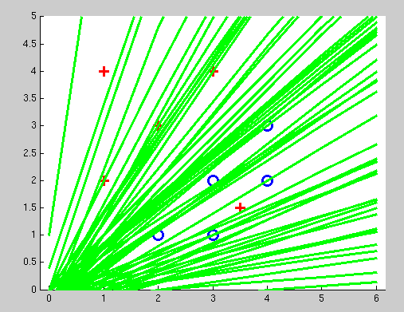
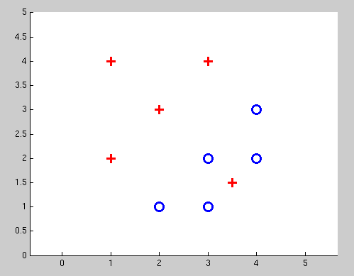
Examples: Perceptron
Non-Separable Case

Slide 21
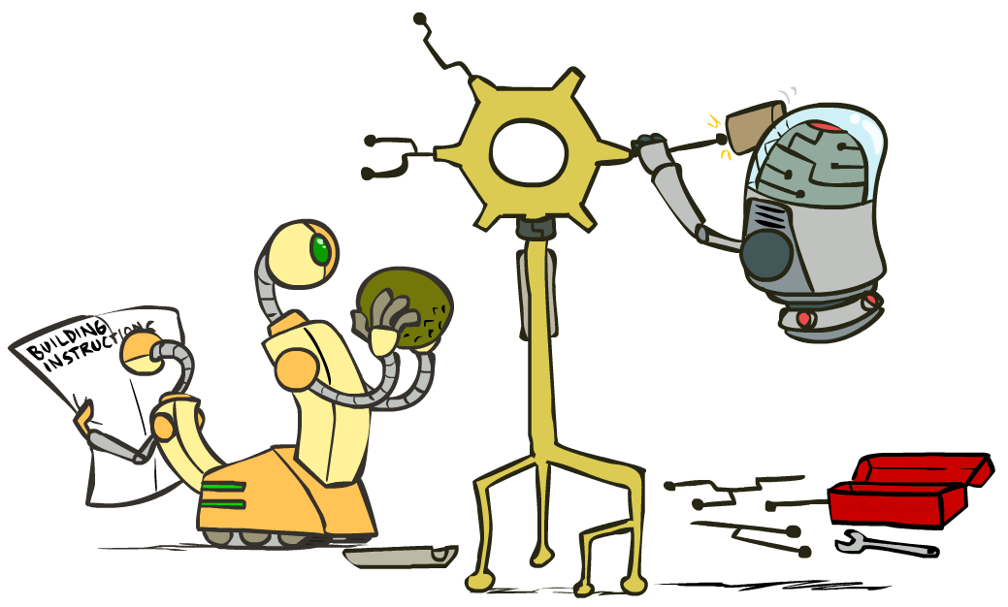
Improving the Perceptron

Slide 22
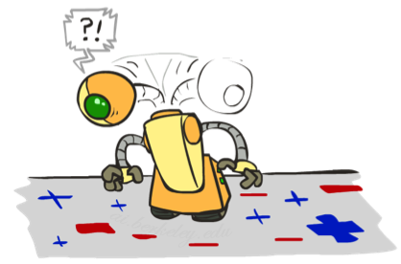
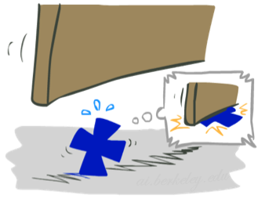

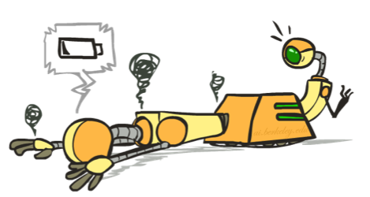
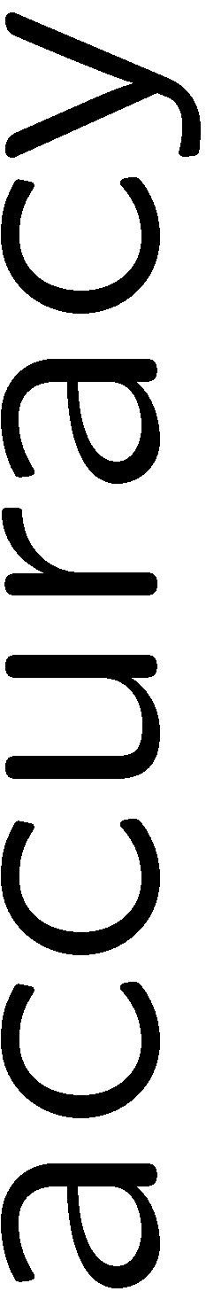



Problems with the Perceptron
Noise: if the data isn’t separable, weights might thrash
Averaging weight vectors over time can help (averaged perceptron)
Mediocre generalization: finds a “barely” separating solution
Overtraining: test / held-out accuracy usually rises, then falls
Overtraining is a kind of overfitting
Notes:
3. Overtraining is easy to fix. Use held-out data to avoid overtraining via “early stopping”.
Next, we will turn to an algorithm that helps the first two problems. It will help us find a better decision boundary, and it will help us avoid thrashing around.

Slide 23
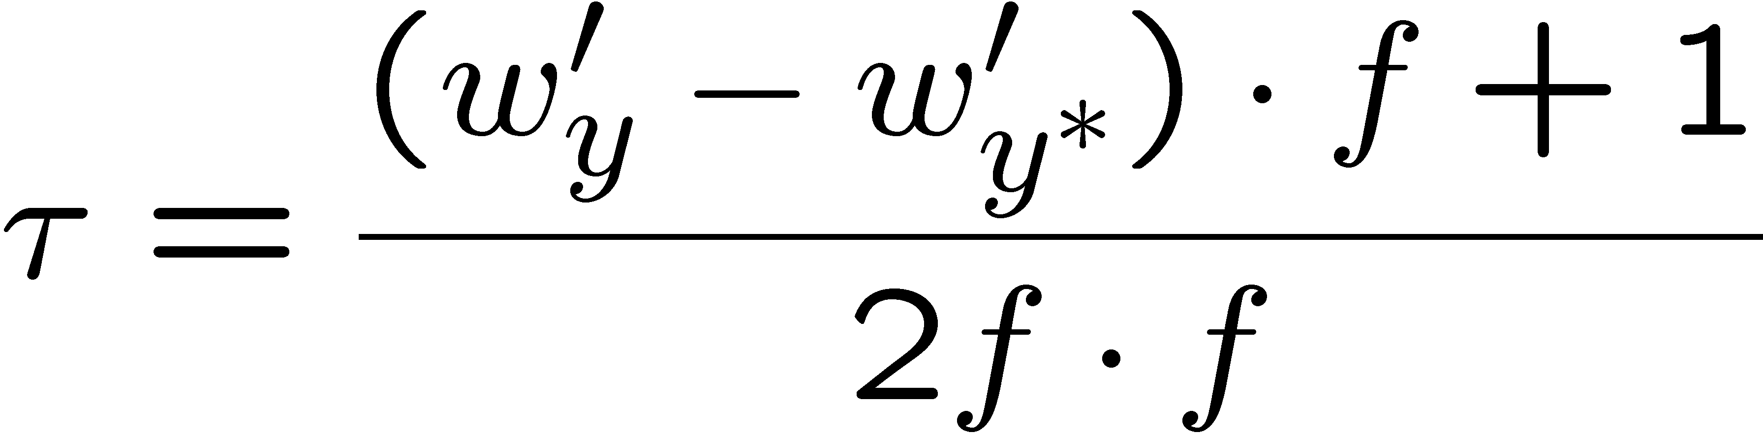
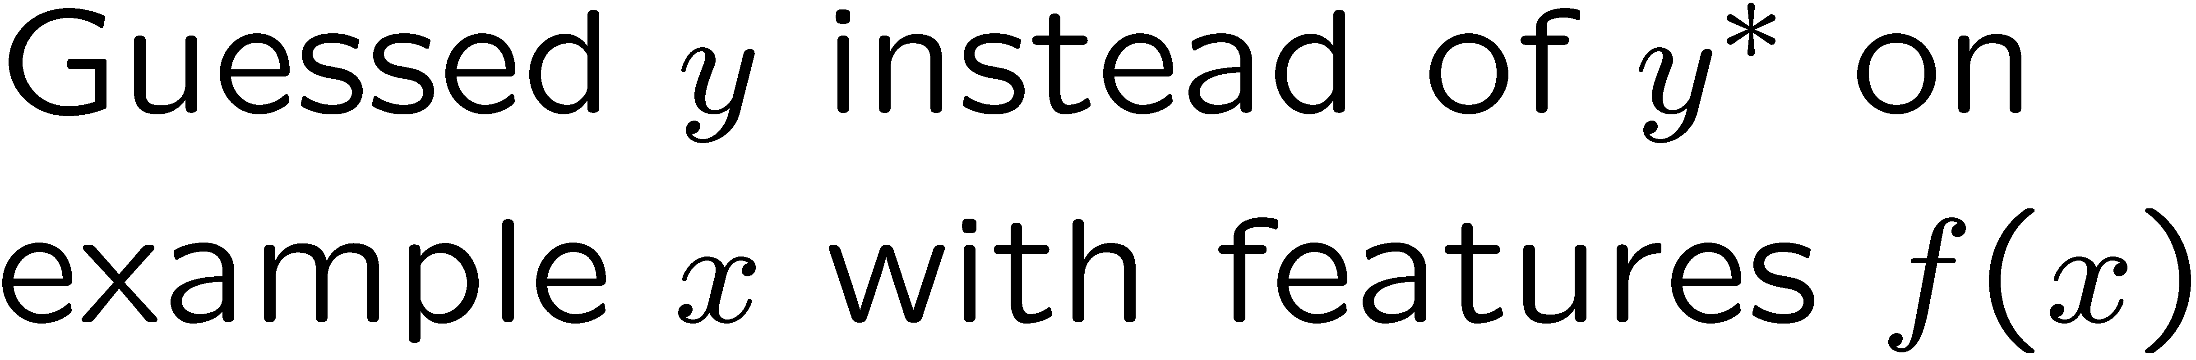
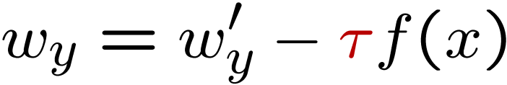
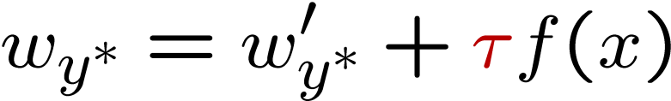
Fixing the Perceptron
Idea: adjust the weight update to mitigate these effects
MIRA = Margin Infused Relaxed Algorithm
Choose an update size that fixes the current mistake…
… but, minimizes the change to w
The +1 helps to generalize
Notes:
MIRA does the following when you make an error:
You re-scale your features by some value Tau. This is like the alpha that we saw in Q-learning. It is a learning rate in some sense. Unlike in Q-learning where this was set heuristically, we are going to have a principled way of setting Tau.
Let’s take a look at it pictorially. We wanted to classify the current thing as y*, but we came up with y as our prediction. What we normally do is subtract out f from wy, and add it to w*, and that would be the perceptron update.
Now we’re going to allow some scaling via tau. Not too much, not too little.
So here’s the equation that we use to choose an update size. We want to pick a new update that has the weight vector for each class (w_y’) to be as close as possible to w_y. You could make that true by just setting w_y’ to be w_y.
But there’s a constraint. We want the w_y to be better for the current item f(x). That’s the second term. And not only do we want it to be better than our previous prediction, and we want it to be correct by a margin of at least +1. This is saying that y* has to be getting a higher score than y +1.
The plus one gives us some margin.
Now we need to solve this. The next slide shows the optimization problem.

Slide 24
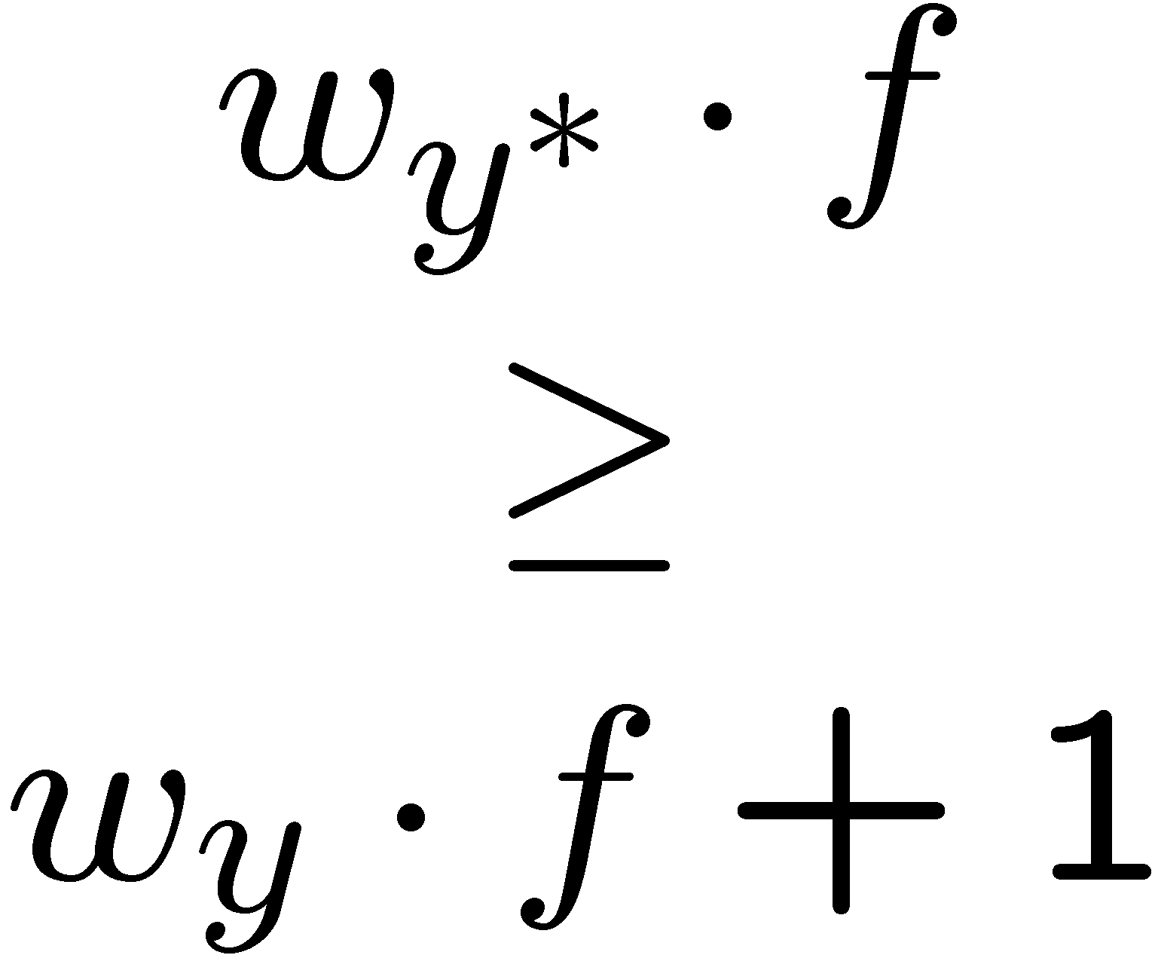
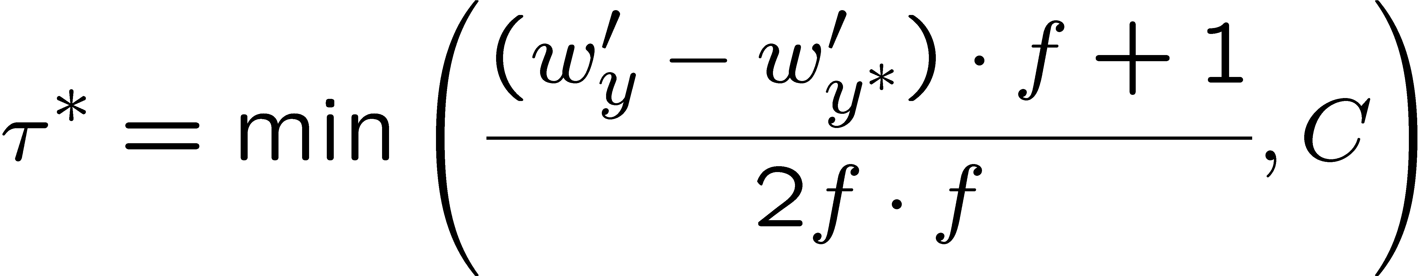

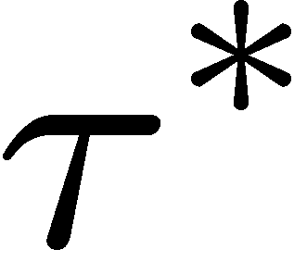

Maximum Step Size
In practice, it’s also bad to make updates that are too large
Example may be labeled incorrectly
You may not have enough features
Solution: cap the maximum possible value of τ with some constant C
Corresponds to an optimization that assumes non-separable data
Usually converges faster than perceptron
Usually better, especially on noisy data

Slide 25
Linear Separators
Which of these linear separators is optimal?

Slide 26
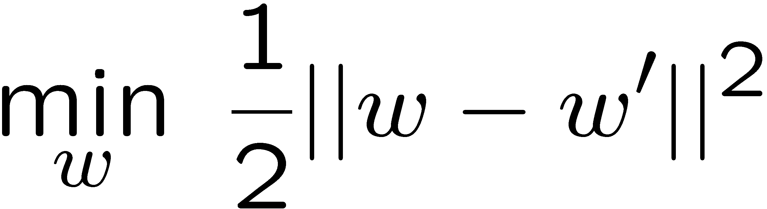
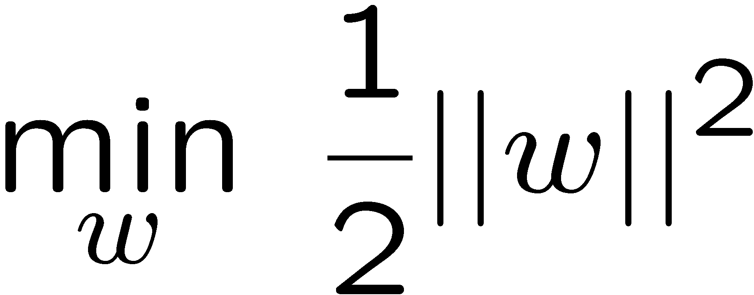
Support Vector Machines
Maximizing the margin: good according to intuition, theory, practice
Only support vectors matter; other training examples are ignorable
Support vector machines (SVMs) find the separator with max margin
Basically, SVMs are MIRA where you optimize over all examples at once
MIRA
SVM

Slide 27
Non-Linear Separators
Data that is linearly separable works out great for linear decision rules:
But what are we going to do if the dataset is just too hard?
How about… mapping data to a higher-dimensional space:
0
x
0
x
x²
0
x
This and next few slides adapted from Ray Mooney, UT

Slide 28
Non-Linear Separators
General idea: the original feature space can always be mapped to some higher-dimensional feature space where the training set is separable:
Φ: x → φ(x)

Slide 29
Classification: Comparison
Naïve Bayes
Builds a model training data
Gives prediction probabilities
Strong assumptions about feature independence
One pass through data (counting)
Perceptrons / MIRA:
Makes less assumptions about data
Mistake-driven learning
Multiple passes through data (prediction)
Often more accurate

Slide 30
Perceptrons for decision making
A complex network of perceptrons could make quite subtle decisions:
Layer 3
Complex decisions can be made by the perceptron in the third layer
Layer 1
Layer 2
1st layer makes 3 simple decisions by weighing the input evidence
2nd layer makes a decision by weighing up the results from the 1st layer of decision-making
Notes:
In this network, the first column of perceptrons - what we'll call the first layer of perceptrons - is making three very simple decisions, by weighing the input evidence. What about the perceptrons in the second layer? Each of those perceptrons is making a decision by weighing up the results from the first layer of decision-making. In this way a perceptron in the second layer can make a decision at a more complex and more abstract level than perceptrons in the first layer. And even more complex decisions can be made by the perceptron in the third layer. In this way, a many-layer network of perceptrons can engage in sophisticated decision making.

Slide 31
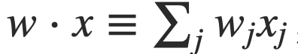


Weights, bias and dot products
Two notational changes simplify the way that perceptrons are described.
The first change is to replace the weighted sum as a dot product
The second change is to move the threshold to the other side of the inequality, and to replace it by a bias, b≡−threshold
$$output= \left\{\begin{aligned}0 if \sum_{j}{wjxj} ≤threshold \\ 1 if\sum_{j}{wjxj}>threshold\end{aligned}\right.$$
$$output= \left\{\begin{aligned}0 if w ∙x+b ≤0 \\ 1 if w ∙x+b >0\end{aligned}\right.$$
Notes:
You can think of the bias as a measure of how easy it is to get the perceptron to output a 1. Or to put it in more biological terms, the bias is a measure of how easy it is to get the perceptron to fire. For a perceptron with a really big bias, it's extremely easy for the perceptron to output a 1. But if the bias is very negative, then it's difficult for the perceptron to output a 1.

Slide 32
Logical functions
Networks of perceptrons to compute any logical function
We can build any computation up out of NAND gates.
For example, a circuit which adds two bits x₁ and x₂
All unlabeled weights are -2, all biases =3.
Notes:
we can use networks of perceptrons to compute any logical function at all. The reason is that the NAND gate is universal for computation, that is, we can build any computation up out of NAND gates.
The NAND example shows that we can use perceptrons to compute simple logical functions. In fact, we can use networks of perceptrons to compute any logical function at all. The reason is that the NAND gate is universal for computation, that is, we can build any computation up out of NAND gates. For example, we can use NAND gates to build a circuit which adds two bits, x1 and x2. This requires computing the bitwise sum, x1⊕x2x1⊕x2, as well as a carry bit which is set to 1 when both x1 and x2 are 1, i.e., the carry bit is just the bitwise product x1x2:

Slide 33
The XOR problem
A single neural unit cannot be used to compute the XOR function
AND
OR
XOR
x1 | x2 | y
0 | 0 | 0
0 | 1 | 0
1 | 0 | 0
1 | 1 | 1
x1 | x2 | y
0 | 0 | 0
0 | 1 | 1
1 | 0 | 1
1 | 1 | 1
x1 | x2 | y
0 | 0 | 0
0 | 1 | 1
1 | 0 | 1
1 | 1 | 0

Slide 34
The XOR Problem
Notes:
The functions AND, OR, and XOR, represented with input x1 on the x-axis and input x2 on the y axis. Filled circles represent perceptron outputs of 1, and white circles perceptron outputs of 0. There is no way to draw a line that correctly separates the two categories for XOR.

Slide 35
The XOR Solution
Notes:
There are three ReLU units, in two layers; we’ve called them h1, h2 (h for “hidden layer”) and y1. As before, the numbers on the arrows represent the weights w for each unit, and we represent the bias b as a weight on a unit clamped to +1, with the bias weights/units in gray.
Note that the solution to the XOR problem requires a network of units with non- linear activation functions. A network made up of simple linear (perceptron) units cannot solve the XOR problem. This is because a network formed by many layers of purely linear units can always be reduced (shown to be equivalent to) a single layer of linear units with appropriate weights, and we’ve already shown (visually, in Fig. 7.5) that a single unit cannot solve the XOR problem.

Slide 36
The XOR Solution
Notes:
The hidden layer forming a new representation of the input. Here is the rep- resentation of the hidden layer, h, compared to the original input representation x. Notice that the input point [0 1] has been collapsed with the input point [1 0], making it possible to linearly separate the positive and negative cases of XOR.
Filled circles represent perceptron outputs of 1, and white circles perceptron outputs of 0. There is now a way to draw a line that correctly separates the two categories for XOR.

Slide 37
Activation Functions
Instead of directly outputting z = w·x+b, which is a linear function of x, neuron units apply a non-linear function f to z.
The output of this function is called the activation value for the unit, represented by the variable a. The output of a neural network is called y, so if the activation of a node is the final output of a network then
y=a= f(z)
There are 3 commonly used non-linear functions used for f: The sigmoid function The tanh function The rectified linear unit ReLU
The sigmoid function

Slide 38
Activation Functions
The sigmoid function
tanh
ReLU
Notes:
These activation functions have different properties that make them useful for differ- ent language applications or network architectures. For example the rectifier func- tion has nice properties that result from it being very close to linear. In the sigmoid or tanh functions, very high values of z result in values of y that are saturated, i.e., extremely close to 1, which causes problems for learning. Rectifiers don’t have this problem, since the output of values close to 1 also approaches 1 in a nice gentle linear way. By contrast, the tanh function has the nice properties of being smoothly differentiable and mapping outlier values toward the mean.
In practice, the sigmoid is not commonly used as an activation function.

